Slide 1

CPEMS
2025 and 2026

Slide 2
2025 Numbers
544 Total calls. 7 calls less than last year.
Record Breaking Call Volume for October with a total of 67 Calls.
Ended the year with 51 Members.
Wednesdays were the busiest day of the week.
Noon time was the busiest time during the day
Falls were the highest reason for 911 calls
10 PNB’s
Enroute within 3 minutes

Slide 3
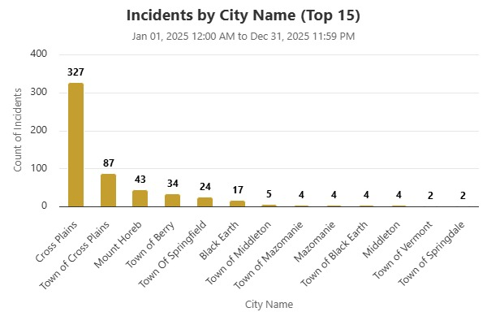
2025 Numbers
Notes:
Village had 58.09% of the calls, Town of Cross Plains had 15.99% of the calls, Town of Berry had 5.88% of the calls and Springfield had 4.41% of the calls. Please notice that we had many calls in other places.

Slide 4
WRS
Our category is “protective with social security”
Employee (26,25,24) | 7.2% | 6.95% | 6.90%
Employer | 14.7% | 14.95% | 14.30%
Total | 21.9% | 21.96% | 21.22%

Slide 5
Health Insurance
Local, 88%
Employee | Type | Family/Single | Employee Pays | Employer
Holly | Quartz | Family | $350.00/mo | $2,218.66
Brian | None | None | None | None
Empty Spot | ? | ? | ? | ?
Hannah | Quartz | Single | $142.17 | $902.73

Slide 6
Income Continuation Insurance
Still on holiday for 2026

Slide 7
Dental
CPEMS does not pay any portion of Dental Coverage
 | 2026 | 2025
Holly | $105.89 | $105.89
Brian | None | None
Open Spot | ? | 0
Hannah | $39.29 | $39.29

Slide 8
Life Insurance
July of 2026 will show a $0.35 premium increase for each unit of spouse and dependent coverage. CPEMS pays ***
.
 | 2026 | 2025
Holly | $11.15 | $9.40
Brian | $18.24 | $16.84
Open Spot | ? | ?
Hannah | $12.35 | $12.00

Slide 9
Things to think about adding…
Vision
CPEMS covers a portion of dental OR we add dental to State of WI plan with WRS. Currently we have a separate plan.
Accident Plan through Securian Financial.
We can discuss this in October 2026 when we will have updated numbers and options.

Slide 10
Wisconsin EMS Association (WEMSA)
Cross Plains EMS won the 2025 excellence in service.
Holly, Brian, Kelly and CJ will be attending the Banquet and Awards Ceramony to receive the award. Ceramony is February 6, 2026 in Green Bay.
Holly will be attending Leadership Conference through WEMSA in February 2026.
Multiple members will be attending education courses through WEMSA conference.

Slide 11
Goals for 2026
3Q2026
Recruitment Plan
Improved CPR program
SOP Updates
Community AEMT Program
1Q2026
Level Set Expectations
Solidify Check-In Process
Stop The Bleed outreach
Solidify Inventory Management
Rig Maintenance
Safety/Exposure Plan Updates
2Q2026
Intermix Training Groups/Teams
Monthly Skills Check-Off Process
Documented Taskbooks
Advanced class outreach
R32 Plan Implementation
4Q2026
Leadership Development Plan (Full Time)
Member Development Track (Part Time & Volunteers)
Territory exploration/expansion

Slide 12
Community AEMT Program
Holly and Brian should finish class in April of 2026, and then will take an exam for National Certification.
Dr. Pearce, our medical director, is currently looking at protocols and services we could offer. Once this is finalized it will be brought to this board for approval.
Once approved we will be meeting with CPPD to see how we can work together for community members having a mental health crisis. We will also be meeting with the Senior Center.

Slide 13
2026 Delegation's
Seth Ramer, (PT) will start keep our statistics for calls and responses.
Kate Gallagher (PT) will be making sure all of our reports are uploading to billing company, check billing and make sure we are charging for all supplies and that we are recouping all possible money. She will also be helping with WIGEMT
Kelly and Tim Powell (V) have come up with a maintenance program with Braun to keep R33 in good condition. They also are certified CEVO/EVOC instructors, making sure everyone who drives our ambulances are trained and safe.
Hannah Dresen (V) will be updating the website
Darick (PT) and Hannah (FT) will be taking care of inventory. Making sure we do not overorder and keep our waste at a minimum.
Katrina Mckee will again be our Safety Officer and Infection Control Officer.

Slide 14
Continued…..
Jordan Zimmermann (PT) will now act as our Training Officer. She will make sure that our training high quality and that each member is practicing at the top of their scope.
Mike Ripp (V) and Hannah (FT) will be our stations maintenance people, keeping our station up to date and safe.

Slide 15
Things to keep in mind….
2027 we will be due for an audit
January 2027 we will need to decide what we will be doing with R32 (old Ambulance)

